Slide 1
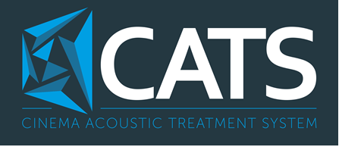

Slide 2
CATS – CINEMA ACOUSTIC TREATMENT SYSTEM
CATS is a unique acoustical treatment system designed to offer the maximum performance with the minimum loss of space across all frequencies.
CATS has been designed to specifically address the “three Rs of acoustics” - Resonance, Reverberation and Reflection.
Each component in the system is targeted at one of these three acoustical problems resulting in a comprehensive and repeatable solution that remains easy to install and integrate in to the room.
All of this is achieved within a depth of just 50mm.

Slide 3
RESONANCE
Low frequency sounds have a very long wave length, up to 20m in home cinema.
As these waves are so long, they are bounced back on themselves by the room boundaries resulting in many of the most noticeable acoustic artefacts.
The effect of sound waves bouncing repeatedly between the room boundaries is called resonance.

Slide 4
REVERBERATION
Sound waves can be long and travel at surprisingly low speed.
As the sound waves bounce off the room boundaries they lose some energy but do not disappear completely.
We can hear these repeated sounds for some amount of time after the original sound is over.
The effect of sound waves taking some to decay to silence is called reverberation.

Slide 5
REFLECTIONS
Sound waves travel in straight lines and when they hit a boundary they are bounced back in a very specific direction.
This is very much like the behaviour of a pool ball bouncing off the cushion.
Our auditory system uses these spatial cues to work out where sounds are coming from so they are very important to our experience.
The effect of sound waves bouncing off a boundary is called reflection.

Slide 6
CATS – DESIGN SERVICE
Step 1
  Using a proprietary computer model calculate the quantity of each panel required to meet our strict reverberation target.
Step 2
  Position low frequency effects speakers and CATS Multipanels to optimise the resonance response of the room.
Step 3
  Position the scattering panels and remaining Multipanels to optimise the reflection response of the room.

Slide 7
CATS MULTIPANEL – HARD SIDE
This is a diaphragmatic absorber which is used to control resonance in the low frequency range
Sound waves have their highest pressure at the room boundaries. This pressure causes the Multipanel to compress converting the sound energy in to motion.
Reducing the energy of the sound wave at the boundary greatly reduces the strength of the wave being bounced back in to the room
The Hard Side of the Multipanel is only effective against the lowest frequency waves. A large area of these panels is the key to efficiency of CATS at low frequencies.

Slide 8
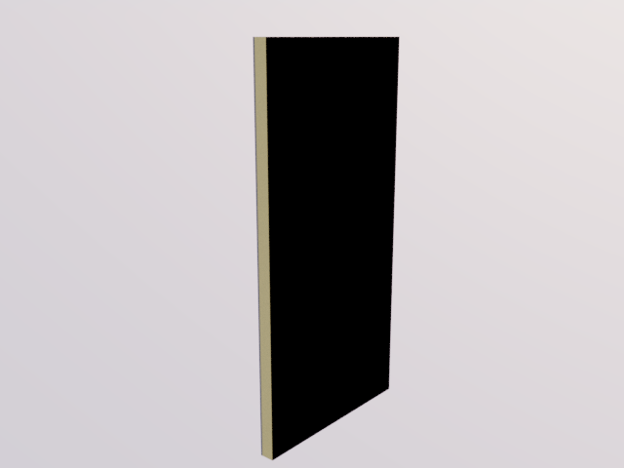
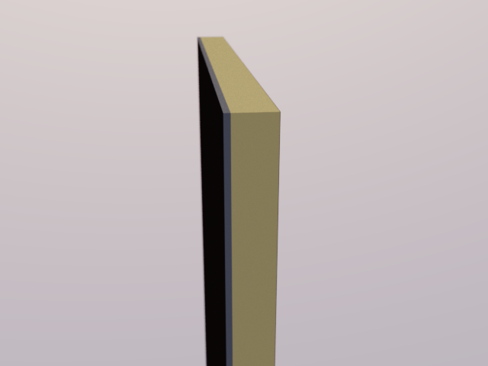
CATS MULTIPANEL

Slide 9
CATS MULTIPANEL – SOFT SIDE
This is a porous absorber which is used to control reverberation in the mid to high frequency range.
Sound waves cause movement of air particles which are obstructed by the fibres in the multipage converting the sound energy in to tiny amounts of heat.
The Soft Side of the Multipanel becomes more efficient as frequency increases. It must be used sparingly to help meet CATS reverberation targets.

Slide 10
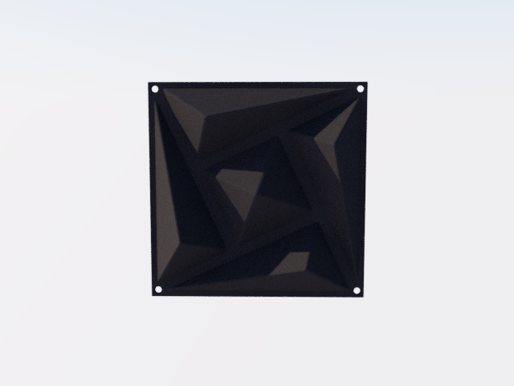
CATS SCATTERING PANEL

Slide 11
CATS SCATTERING PANEL
This panel has been designed specifically for the CATS system and provides effective scattering to around 500Hz.
The panel is injection moulded from a very strong 3mm ABS plastic to provide the best possible performance and stability.
The numerous irregular shaped faces cause the sound waves to be scattered rather than directly reflected back in to the room.
These scattered waves are reduced in energy and broadly dispersed which greatly improves the sense of spaciousness in the room and reduces the problem of reverberation.
By scattering rather than absorbing much of the sound CATS results in a very high efficiency sound transfer which can be clearly heard in the improved dynamics and clarity of the overall audio system.

Slide 12
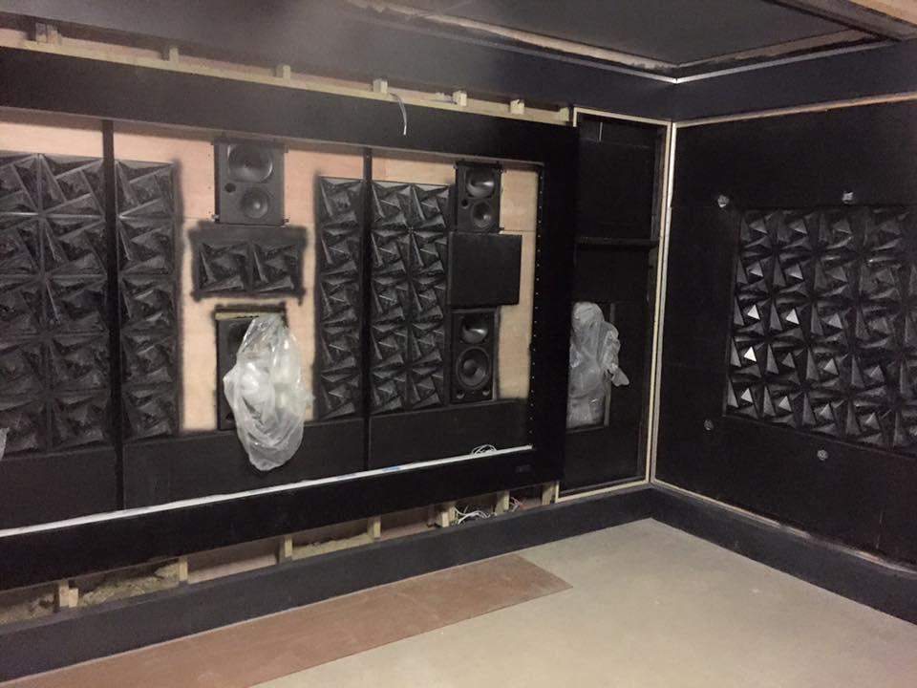
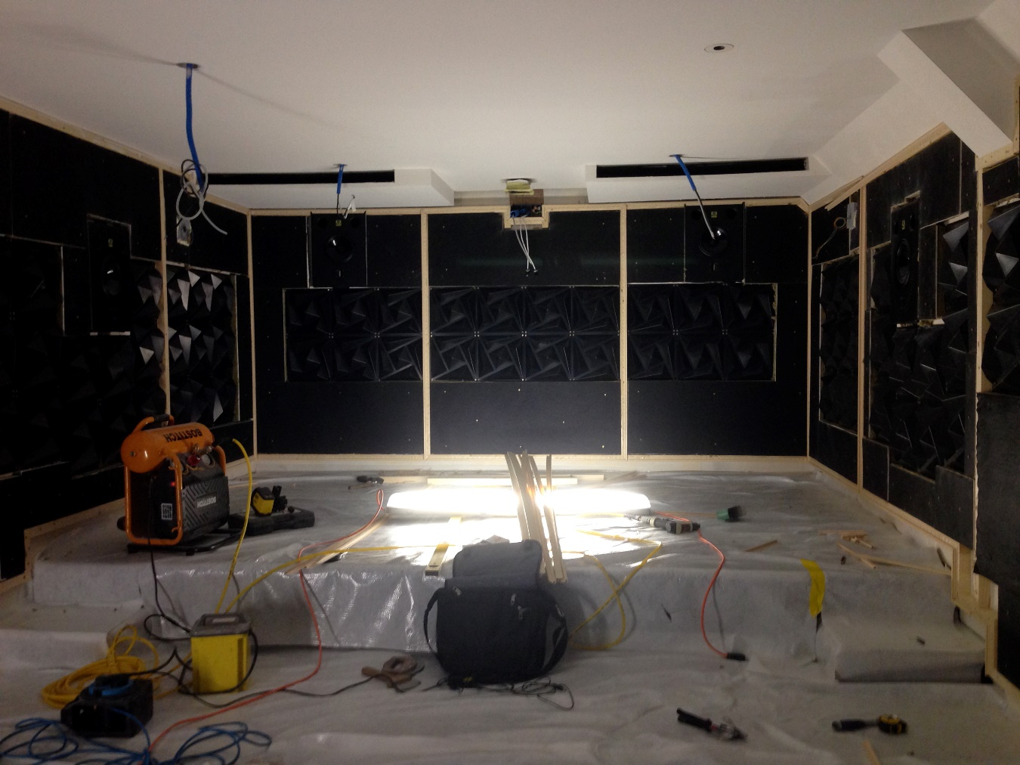
RECENT PROJECT EXAMPLES

